Slide 1
IOT 4113: IoT Architecture and Technologies

Slide 2

Chapter 20
Network Layer:
Internet Protocol
Copyright © The McGraw-Hill Companies, Inc. Permission required for reproduction or display.

Slide 3
Background
In chapter 19 we studied how to assign addresses to nodes in a network.
Addresses assigned to nodes are logical addresses called IP addresses.
This chapter is about the IP i.e. the Internet protocol used at the network layer.
NOTE:
Kindly do not confuse IP address with IP protocol. These are two different things.

Slide 4
Data link Vs. Network Layer
Data link layer provides hop to hop delivery.
Network layer provides host to host delivery.
If the transmission is within a network we use only physical and data link layer.
If the transmission is outside the network we use network layer+data link+physical layer.

Slide 5
20-1 INTERNETWORKING
In this section, we discuss internetworking, connecting networks together to make an internetwork or an internet.
Topics discussed in this section:
Need for Network Layer Internet as a Datagram Network Internet as a Connectionless Network

Slide 6
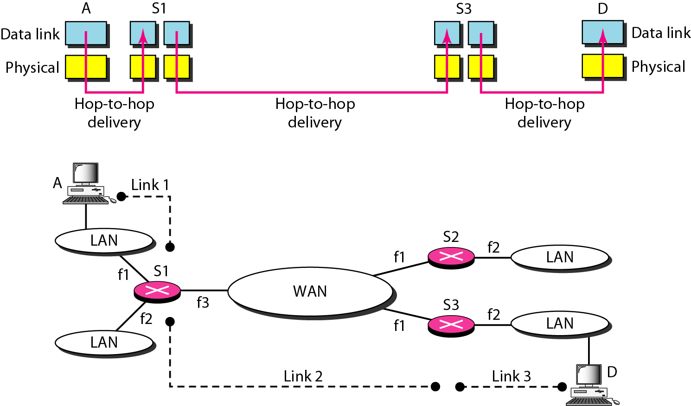
Figure 20.1 Links between two hosts

Slide 7
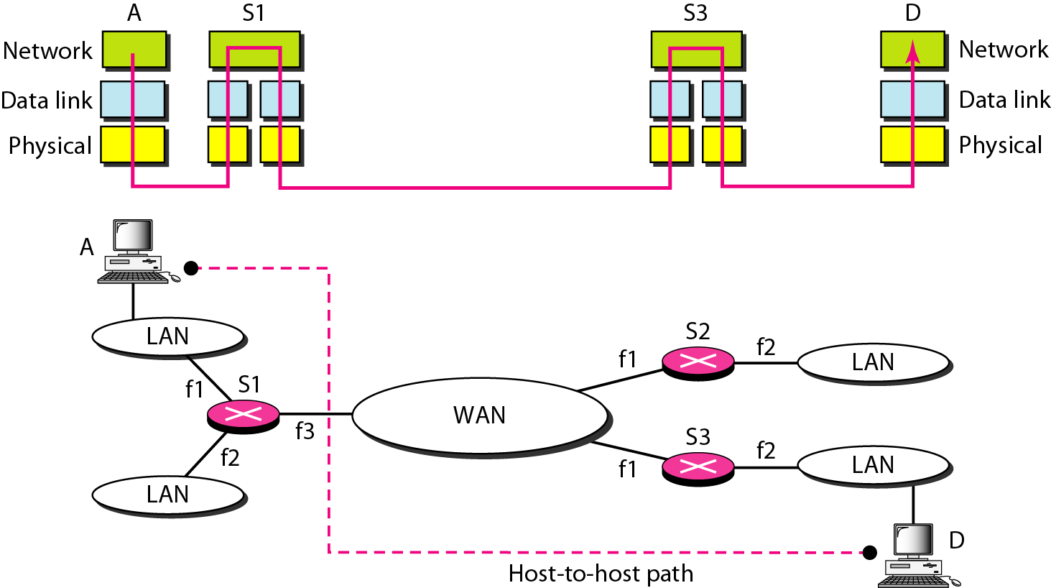
Figure 20.2 Network layer in an internetwork

Slide 8

Note
Switching at the network layer in the Internet uses the datagram approach to packet switching.

Slide 9
Note
Communication at the network layer in the Internet is connectionless.

Slide 10
20-2 IPv4
The Internet Protocol version 4 (IPv4) is the delivery mechanism used by the TCP/IP protocols.
Topics discussed in this section:
Datagram Fragmentation Checksum
Options

Slide 11
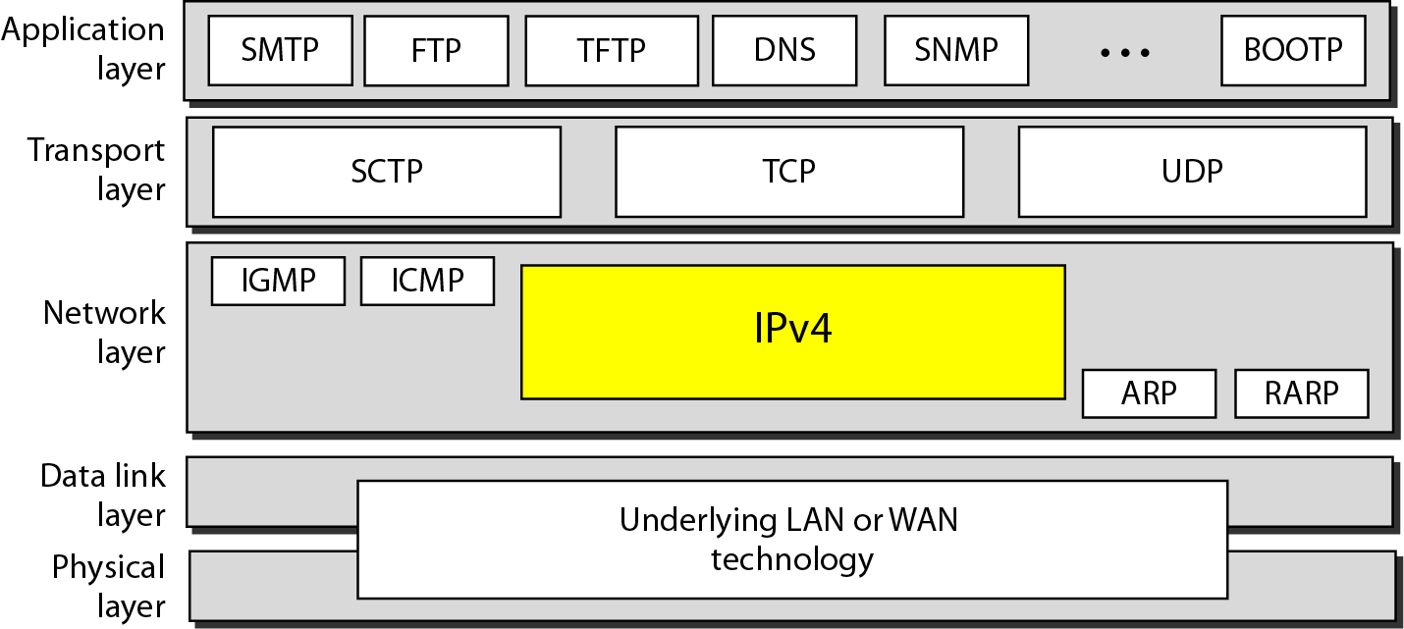
Figure 20.4 Position of IPv4 in TCP/IP protocol suite

Slide 12
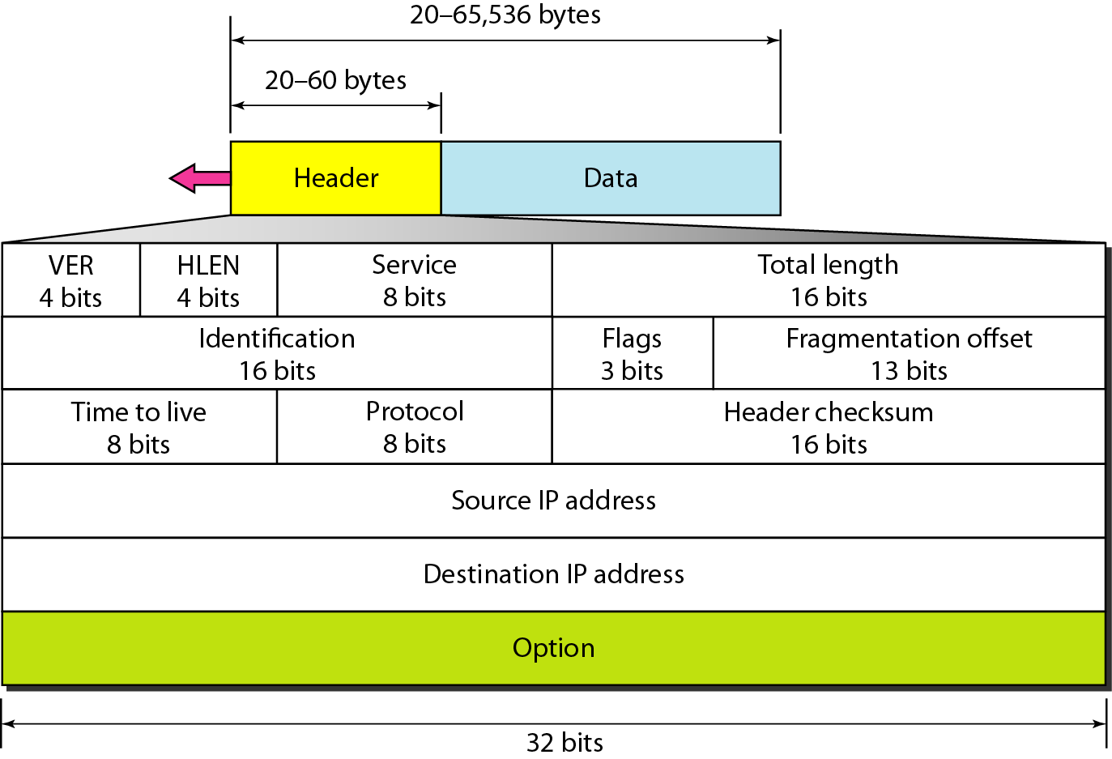
Figure 20.5 IPv4 datagram format

Slide 13
IPv4 Datagram Format
IPv4 Packet is called datagram.
A datagram is of variable length.
Consists of two parts: Header + Data
Header’s length is 20 to 60 bytes.
Header contains information essential for routing and delivering Data.
It is customary in TCP/IP to show the header in 4-byte sections.

Slide 14
Header Fields (1)
VERSION (VER)
4 bit in length
Defines the version of IP (either IPv6 or IPv4)
Header Length (HLEN)
4 bit in length
Defines the length of the header.
Its value falls between 20 to 60 bytes

Slide 15
Header Fields (2)
Services
the IETF has changed the interpretation and name of this 8-bit field.
It was previously called as service type, now called differentiated services.
I will explain “service type”.
“differentiated services” is your homework. (See: SECTION 20.2 Page 585)

Slide 16
Service Type(1)
First 3 bits are Precedence bits.
Next 4 bits are called Type of Service (TOS) bits,
and the last bit is not used.
Precedence:
Value ranges from 000 to 111.
Defines priority of the datagram
Used in situations of Network Congestion
Router discards datagrams of low precedence in case of congestion.

Slide 17
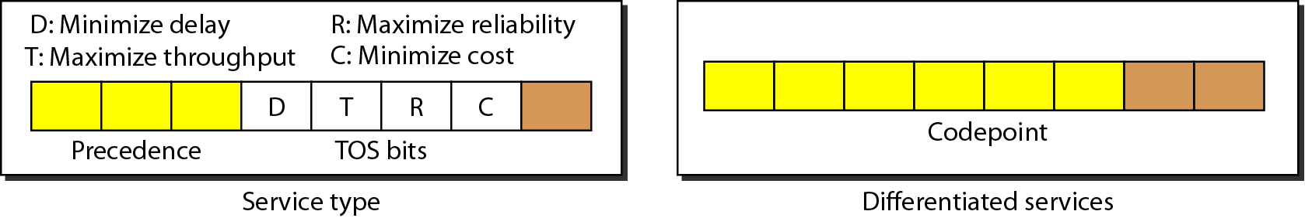
Figure 20.6 Service type or differentiated services

Slide 18
Service Type(2)
TOS bits
4 bit in length
Out of 4 only a single bit can be 1 at a time, thus we have 5 different types of services.
Bit patterns and their interpretations are shown below.

Slide 19
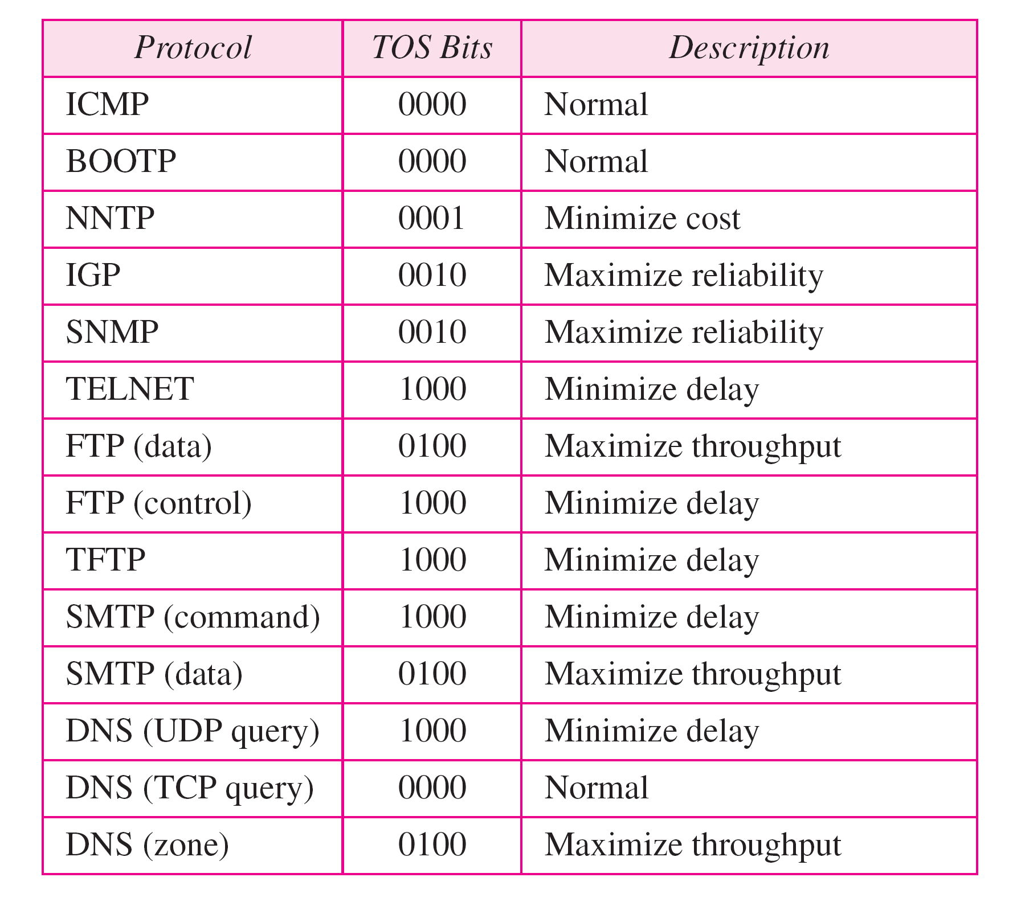
Table 20.2 Default types of service

Slide 20
Total Length
This field defines the total length of the Datagram (header + Data)
Value lies between 20 to 65536 bytes.

Slide 21
Time to Live
A datagram has a limited lifetime in its travel through an internet.
It holds a timestamp which is decremented on each visit of a router.
The datagram is discarded when the value of this field becomes zero.
The purpose is prevent datagram from monopolizing the network and causing congestion.

Slide 22
Protocol
8-bit length
It defines the higher level protocol that uses the services of the IPv4 Layer.
It defines the higher level protocol to which the IPv4 datagram is delivered.

Slide 23
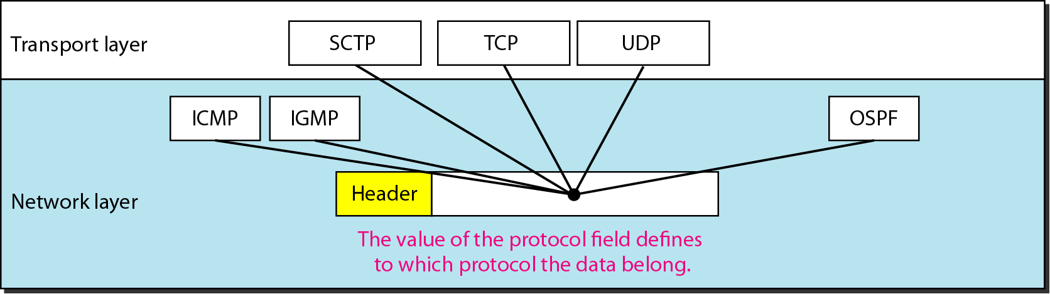
Figure 20.8 Protocol field and encapsulated data
Notes:
SCTP- Stream Control Transmission Protocol

Slide 24
Table 20.3 protocol values

Slide 25
Checksum
An error detection mechanism
Performed only with header fields
Detects error in header part of datagram only.

Slide 26
Source/ Destination Address
Source Address
32 bit field
Defines the IPv4 address of the source
Remains unchanged during travel from source to destination.
Destination Address
32 bit field
Defines the IPv4 address of the destination
Remains unchanged during travel from source to destination.

Slide 27
Fragmentation
Why Fragmentation is Required?
A datagram can travel through different networks whose Protocols are defined by the data link and Physical Layer.
We know that at the data link layer we deal with Frames.
For different network Protocols at data link layer we have different formats and sizes of frames.
Now we also know that the Packet from network layer called datagram (Header + data) act completely as data for the data link Frame.

Slide 28
Fields Related To Fragmentation
Identification
16-bit field
Each datagram is assigned a unique number
When the datagram is fragmented the same identification number is copied to all the fragments.
Flags
3 bit field
1st bit is reserved

Slide 29
Continued…..
2nd bit is Do not Fragment
if the value of this field is 1 the machine must not fragment the datagram. If it cannot pass the datagram though any available physical network, it discards the datagram and sends and ICMP error message to the source host.
If the value is 0, this means that whenever required the datagram can be fragmented according to the requirement of the physical network it is travelling.
3rd bit is More Fragment
If its value is 1, it means this is not the last fragment more fragments have to come.
If its value is 0, it means this is the last fragment or the only fragment.

Slide 30

Figure 20.10 Flags used in fragmentation

Slide 31
Continued…..
Fragmentation Offset
13 bit Field
Shows the relative position of the fragment in the whole datagram.
Offset is measured in units of 8 bytes.

Slide 32
OPTIONS
Options field can be used for network testing and debugging.

